Slide 1


1-D Cluster Variation Method
Object-Oriented Base Code
with
Alianna J. Maren, Ph.D.
Verification and Validation
September 23, 2018

Slide 2
The Object-Oriented Python Code
for a 1-D CVM Grid
GitHub Public Repository:
https://github.com/ajmaren/OOP_CVM-1D_Snippets
The Code:
1D-CVM_OO_basic-config-vars_V-and-V_1-1_2018-09-23.py
Notes: This code currently:
Has only the w (next-nearest-neighbor, in the same row) configuration values computed. No y (nearest neighbor, on the diagonal), no z (triplets).
Is a transition from simple structured code to Object-Oriented (OO) Python
Has been rewritten from the initial test code into a fully structured (procedure / function) code that can be readily expanded for greater functionality.
Website:
www.aliannajmaren.com – see the blog for more info

Slide 3
A Single Zigzag Chain
Showing the Configuration Variables x_{i}, y_{i}, w_{i}, and z_{i}
There are four different kinds of local configuration variables:
x_{i} – the fraction of nodes in their specific activation state
y_{i} – nearest-neighbors
w_{i} – next-nearest-neighbors
z_{i} - triplets
Total numbers of each kind:
x_{i} – two types: A or B (“on” or “off,” respectively)
y_{i} – three types: A-A, A-B (also B-A), and B-B (degeneracy = 2 for A-B / B-A
w_{i} – three types: A--A, A--B (also B--A), and B--B (degeneracy = 2 for A--B / B—A – these occur within the same row for the 1-D case
z_{i} – six types of triplets; two have degeneracies of two each – see next slide

Slide 4
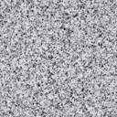

1-D CVM with Two Instances of Base Pattern
Base pattern characteristics:
Requires eight nodes; four A and four B
Yields one instance of each of the different triplets (including the degenerate types)
Doubling the base pattern gives two instances of each of the triplet types
Envelope configuration: wraparound horizontally only
Total number of triplets = number of units
Horizontal wrap-around; identical with leftmost units
Legend
Configuration Variable (Triplet) Values (Equiprobable when h = 1)
z₁ = 0.125
Z₁ = 2
z₂ = 0.125
Z₂ = 2
z_{2var} = 0.125
Z_{2 var} = 2
variant
z₃ = 0.125
Z₃= 2
Unit in state A
Unit in state B
A
A
A
B
A
A
A
B
B
A
A
A
Wrap-around unit in state A
Wrap-around unit in state B
B
z₆ = 0.125
Z₆= 2
B
z₅ = 0.125
Z₅ = 2
B
z₅ = 0.125
Z₅ = 2
variant
A
z₄ = 0.125
Z₄ = 2
B
B
B
A
A
B
B
B
z_{i} = fraction of triplets of type i; Z_{i} = total number of triplets of type i

Slide 5
1-D CVM with One Instance of Base Pattern and One Altered Pattern
Total grid characteristics:
Equal numbers of A and B nodes, but one base pattern is altered
Yields different instance of each of the different triplets (including the degenerate types)
Legend
Unit in state A
Unit in state B
Two nodes interchanged
Wrap-around unit in state A
Wrap-around unit in state B
Summary of Y(i)’s
Nearest-Neighbor (Y) Values
A
y_{2var} = 0.3125
Y_{2 var} = 5
variant
y₃ = 0.1875
Y₃= 3
Y₄ (B-B) = 3
Y₂ (B-A) = 5
y₁ = 0.1875
Y₁ = 3
B
y₂ = 0.3125
Y₂ = 5
A
B
Y₁ (A-A) = 3
Y₂ (A-B) = 5
A
A
B
B
y_{i} = fraction of nearest neighbors of type i;
Y_{i} = total number of nearest neighbors of type i
Summary of Z(i)’s
Configuration Variable (Triplet) Values (Equiprobable when h = 1)
Z₁ (A-A-A) = 1
Z₂ (A-A-B) = 2
Z₂ (B-A-A) = 2
Z₃ (A-B-A) = 3
Z₄ (B-A-B) = 3
Z₅ (B-B-A) = 2
Z₅ (A-B-B) = 2
Z₆ (B-B-B) = 1
z₁ = 0.0625
Z₁ = 1
z₂ = 0.125
Z₂ = 2
z_{2var} = 0.125
Z_{2 var} = 2
variant
z₃ = 0.1875
Z₃= 2
A
A
A
B
A
A
A
B
B
A
A
A
B
z₆ = 0.0625
Z₆= 1
B
z₅ = 0.125
Z₅ = 2
B
z₅ = 0.125
Z₅ = 2
variant
A
z₄ = 0.1875
Z₄ = 2
B
B
B
A
A
B
B
B
z_{i} = fraction of triplets of type i; Z_{i} = total number of triplets of type i

Slide 6
Code Specifics:
Grid Size / Configuration:
2 rows, 12 columns – 24 nodes total
Three instances of “base” pattern (eight nodes per base pattern)
Three “base” pattern instances allow some flexibility in choosing multiple node swaps (for a later code development)
Code Notes:
Written in OO Python; single class is for the object node
Methods not yet fully developed
Structured code; procedures & functions
Start reading from the bottom to get a sense of what is happening
Code Actions:
Define a grid of 24 nodes in two rows; initialize with zero activation value
Assign node activation values according to the “base” pattern
Computes the in-row w configuration values ONLY (no y values, no z-triplets)
Allows the user to select two nodes to swap
Tests the desired swap to see if two nodes have different activations
Performs the swap
Lots of debug print statements throughout, controlled via Boolean for easy turn-on and off

Slide 7
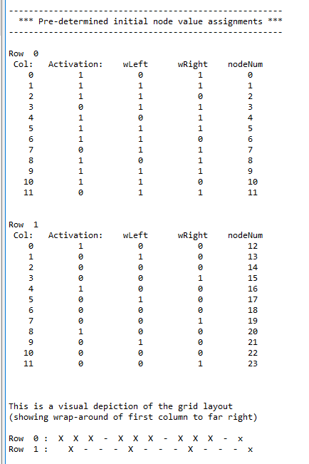
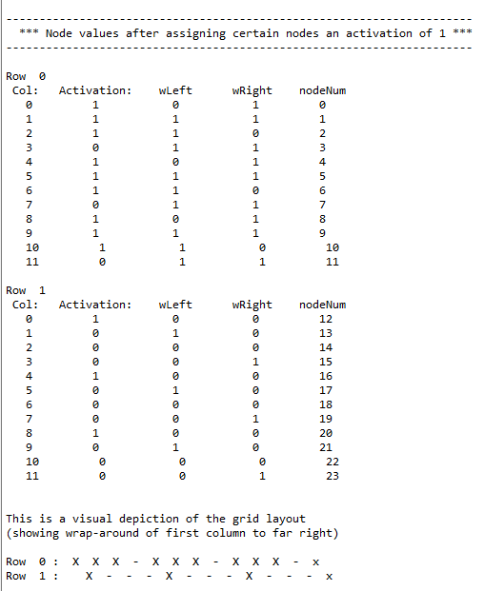
Experimental Results: Object-Oriented Code, 1-D CVM
The Base Grid Plus w-Config Variables
New Structured Code
Original Linear Code
Verification & Validation:
Previous code was extensively hand-validated for the same-row w-values.
New code gives identical results.
The new code provides the same functionality as previous, but is re-organized with a procedure / function structure, all called from __main__.
2D-CVM_OO_basic-config-vars_V-and-V_1-1_2018-09-23.py
2018/09/23
simple_OO-node-list-code_1b_2018-07-29.py
2019/09/23

Slide 8
For More Information:
GitHub Public Repository:
https://github.com/ajmaren/OOP_CVM-1D_Snippets
Website:
www.aliannajmaren.com
Code Availability:
Code will be made available on the public GitHub repository after initial development, documentation, V&V, and experiments are completed.
Look on arXiv for various papers documenting theoretical and experimental results. See the “Patents and Publications” page on www.aliannajmaren.com for full access to the latest papers. See the “Blog” page for discussions on theory, code, and experimental results.
Contact Information:
Alianna J. Maren, Ph.D.:
alianna@aliannajmaren.com
alianna.maren@northwestern.edu

